Slide 1

Let’s Talk About…
An Online Bible Study

Slide 2
Luther’s Legacy

Slide 3
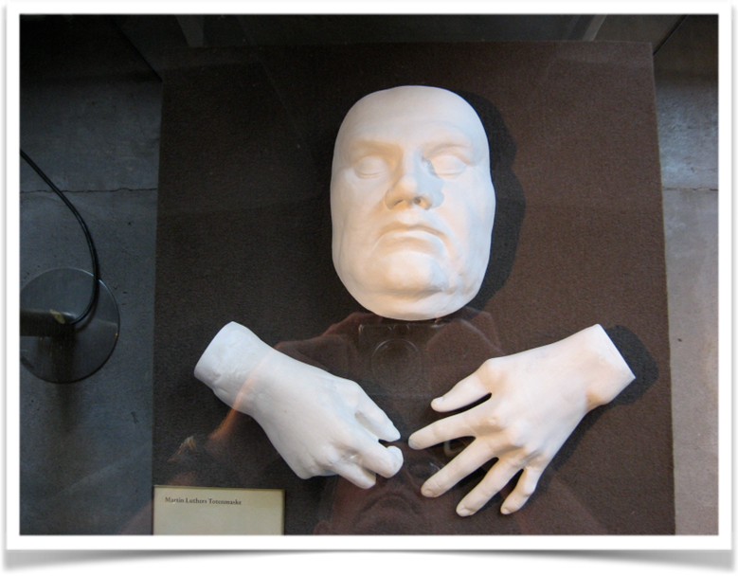

Slide 4
What, exactly, did Martin Luther look like? We’re not sure. He died on February 18, 1546 in the town of Eisleben. The next day, the artist Lukas Furtenagel painted a portrait of Luther in his wooden coffin.

Slide 5
Furtenagel’s work became the basis for other representations of Luther, probably the ones with which we are most familiar, and possibly even my souvenir photograph of his chalky-white death mask.

Slide 6
It doesn’t really matter that we don’t have an accurate photographic image of Luther. It doesn’t matter that some of what we call “Luther sites” in Germany today are actually rebuilds or replicas of the original structures which burned to the ground years ago. The Reformation of the Church is what counts; it is the lasting legacy Luther left.

Slide 7
That legacy? Here are three important aspects:
1. The clear truth of the Gospel
(“Christ gave his body and shed his blood for us for the forgiveness of sin.”) *
2. The confessional theological organization
(Sola Scriptura, Sola Gratia, Sola Fide)
(Scripture alone, Grace alone, Faith alone)
3. The staunch commitment to the authority of God’s Word
(“Here I stand.”)
Notes:
* Written in 1521 “to his fellow Augustinians at Wittenberg about the abuse of the Mass,” according to Ewald M. Plass in WHAT LUTHER SAYS.

Slide 8
Lutheran theology does not focus on Luther himself as an individual or a personal story.
How do the three solas show that?

Slide 9
When we sing, “A Mighty Fortress Is Our God,” we reflect a portion of Scripture Luther found precious, one which sustained his spirit as he led the difficult Reformation of the Church: “The Lord Almighty is with us; the God of Jacob is our fortress (Psalm 46).”

Slide 10
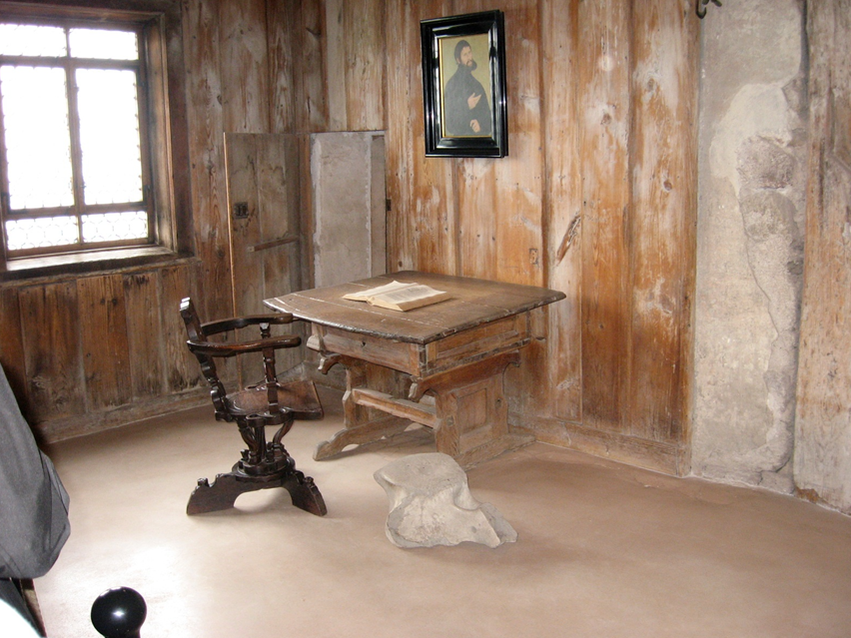

Slide 11
Martin Luther's room at the Wartburg castle in the Black Forest of Saxony, where he was hidden from enemies of the Reformation for ten months. Here he began work on his translation of the Scriptures into German. "Your words are a lamp for my feet and a light for my path (Psalm 119).”

Slide 12
Imagine Martin Luther’s loneliness: apart from his family and friends, secretly hidden away in the Wartburg Castle.
What sustained him during that dark time?
What sustains me during difficulties?

Slide 13
Luther’s Small Catechism was written for family instruction in Bible truths. The Six Chief Parts are a simple presentation of Christian doctrine.
Remember them?
How is this book used in your family or among your congregation?

Slide 14
If Luther had a favorite Bible passage, what do you suppose it might be?
Some candidates might include:
John 3:16
Ephesians 2:8-9
Romans 1:16

