Slide 1

Let’s Talk About…
An Online Bible Study

Slide 2
Worship Worldwide

Slide 3
Picture yourself sitting among fellow-members of the Ukrainian Lutheran Church in Kiev, listening as the pastor conducts the liturgy. You hear him sing . . . your own name. In fact, in prayer he chants the name of every member of the congregation, every Sunday.

Slide 4
Imagine standing before the altar at Seoul Lutheran Church, about to receive the Lord’s Supper. The pastor distributes the bread/Body of Christ and the wine/Blood of Christ . . . wearing white cotton gloves, the traditional Korean formal sign of respect.

Slide 5
Or how about this? You are at worship in the Lutheran Church in the Andes Mountain community of Huaraz in Peru. Taking your turn . . . you rise to read a portion of a Scripture lesson, grateful the congregation is understanding as you stumble through the Spanish.

Slide 6
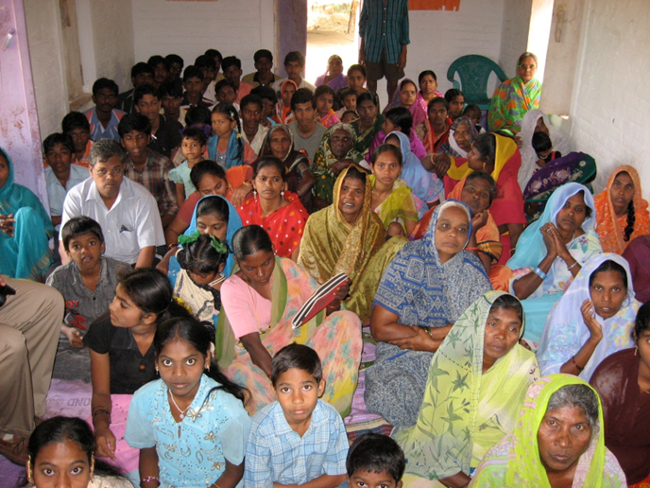

Slide 7
See yourself among the worshipers in a Lutheran Mission of Salvation - India congregation, in a cement-block church . . . sitting on the floor, barefoot. Women and children are seated on mats on one side of the church, men and boys on the other. Hymns are accompanied by a bongo drum.

Slide 8
World-wide, there’s quite a variety of worship practices among confessional Lutherans - but the same saving faith in our Savior! Jesus said, “Blessed rather are those who hear the word of God and obey it (Luke 11).”

Slide 9
What are the most striking differences between my congregation’s worship service and the world-wide worship practices previously described?

Slide 10
Why could I be (or not be) comfortable with worship as conducted in other cultures?

Slide 11
Which is better: following familiar worship patterns or using a variety of worship forms?
How does each have a special benefit for our faith?

Slide 12
What are good reasons for following our traditional worship traditions?
What might be bad reasons for doing that?

Slide 13
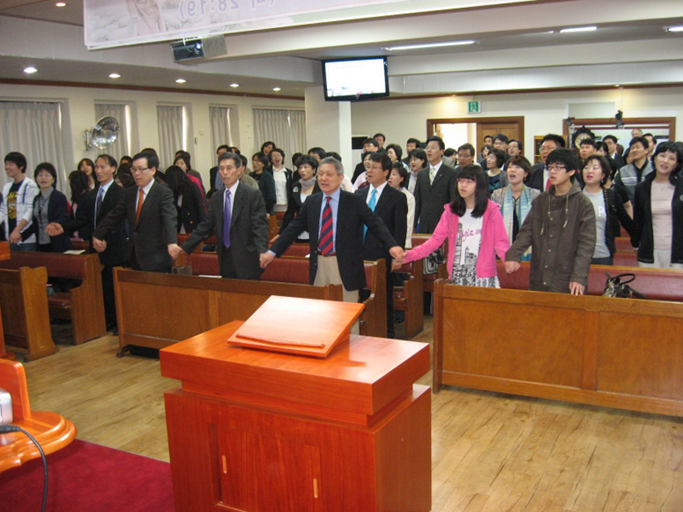
Members hold one anothers’ hands at a worship service at Seoul Lutheran Church.

Slide 14
An informal interlude during a worship service at Seoul Lutheran Church, congregation members join hands and sing, “We are one in the Spirit, we are one in Lord.” This moment is followed by the exchange of greetings throughout the church. After this brief time, the solemnity of the order of worship resumes with a traditional Lutheran liturgy. “I rejoiced with those who said to me, ‘Let us go to the house of the Lord’ (Psalm 122).”

Slide 15
What are the most important parts of our worship services?
Singing hymns?
Confession and forgiveness of sin?
The Creeds?
Prayer?
Scripture reading?
The sermon?
Fellowship with other Christians?
Offering financial support?
Notes:
Fellowship with other Christians?
Offering financial support?

Slide 16
In worship, we are serving God. But in an even more important way, God is serving us! Note the significance of the these words: “the Son of Man did not come to be served, but to serve, and to give his life as a ransom for many (Matthew 20).”

