Slide 1

Let’s Talk About…
An Online Bible Study

Slide 2
The Maids
of Lima

Slide 3
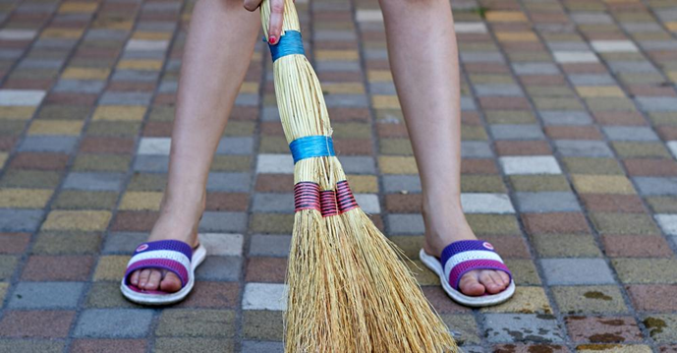

Slide 4
Lying along the shores of the Pacific Ocean, Lima, Peru’s climate is that of a subtropical desert. Most of the year the weather is dry and warm, which means that the city is quite dusty much of the time.

Slide 5
The maids of Lima address that issue. Even many middle-class families have maids. The women who serve in that capacity often come from poorer neighborhoods, and take up residence in the top-floor, one-room, maid’s quarters found in most homes. The maid will be busy each day cleaning, doing laundry, and preparing meals.

Slide 6
In a typical middle-class neighborhood, homes are fronted by a small grass lawn between the front door and a brick wall with iron-work fencing. Beyond that wall and fence - the sidewalk and street. One distinct memory of time spent in Lima is the image of maids at work each daybreak, sweeping the sidewalk in front of their employers’ homes. The dust of a dry climate and the debris of daily life in a crowded city must be cleaned up.

Slide 7
Everyday the same duty is performed because everyday more dust arrives.
Martin Luther admitted for us all that the dust of guilt is a regular feature of our lives. “We sin much every day, “ he said. The writer of Lamentations counters that truth and comforts us, “Because of the Lord’s great love we are not consumed, for his compassions never fail. They are new every morning . . . (Lamentations 3).“

Slide 8
Daily the maids of Lima sweep away debris. For what do I need daily forgiveness: sinful thoughts, words or deeds?
What’s the bigger problem, for which I need to be forgiven?

Slide 9
At worship, as the Gospel is preached, God serves us by reassuring us that “ . . . God was reconciling the world to himself in Christ, not counting men’s sins against them (2 Corinthians 5).”
How do we receive this reconciliation?

Slide 10
What’s the difference between being certain of reconciliation based on how we feel - and being sure of reconciliation based on what God has done for us in Christ and revealed to us in Scripture?

Slide 11
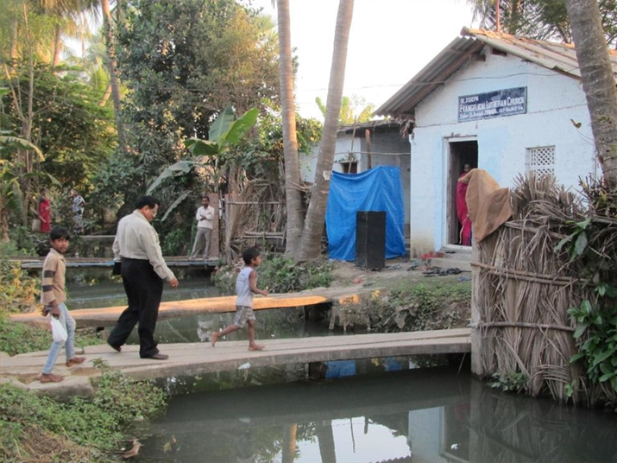
The late Rev. G.J. Ananda Raju crosses the footbridge to St. Joseph’s Lutheran Church in an Indian village.

Slide 12
He trained the pastor of this small congregation for ministry: “Do your best to present yourself to God as one approved, a workman who does not need to ashamed and who correctly handles the word of truth (2 Timothy 2).”

Slide 13
In many ways, congregations in India are no different from ours in the U.S. Sometimes members of our congregation need to be reconciled to one another.
What’s the cause of conflict in my congregation?
Differing expectations? Change? Control?

Slide 14
Paul says God “. . . gave us the ministry of reconciliation.” Pastors “ . . . implore (us) on Christ’s behalf: Be reconciled to God (2 Corinthians 5).”
How does my pastor correctly handle the word of truth in his ministry?

Slide 15
Paul says God “. . . gave us the ministry of reconciliation.” Pastors “ . . . implore (us) on Christ’s behalf: Be reconciled to God (2 Corinthians 5).”
Who placed him in office?
Who trained him?

