Slide 1

Let’s Talk About…
An Online Bible Study

Slide 2
Holy Communion

Slide 3
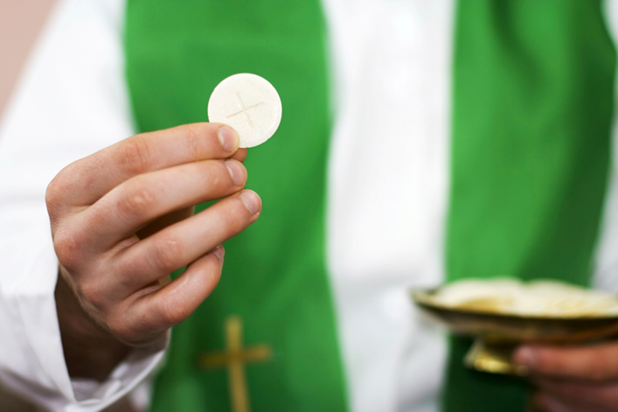

Slide 4
Our Peruvian brothers and sisters have the same Communion practice found in our confessional Lutheran congregations, often called Close Communion. That expresses an emphasis on the agreement in doctrine our celebration of the sacrament demonstrates. Those who commune together are to be close to one another in their understanding of Christian doctrine, and in their faith in Jesus Christ, and in their confession of that faith. That’s why I appreciate the term used in Peru to express this concept: Communio intimo (intimate Communion).

Slide 5
Think of how Communio Intimo describes what happens before our altars:
- the body and blood of Jesus Christ are intimately connected with the earthly elements of bread and wine in what theologians call the “sacramental union”
- also we Christians and our Savior are intimately together when He gives each of us personally His body and blood for the forgiveness of our sins

Slide 6
- and we sinners/saints who kneel together side-by-side are intimately united in fellowship as we receive the Sacrament.
We celebrate fellowship in the Lord’s Supper. Members in our mission fields do, too!

Slide 7
“Is not the cup of thanksgiving for which we give thanks a participation in the blood of Christ? And is not the bread we break a participation in the body of Christ? Because there is one loaf, we, who are many, are one body, for we all partake of the one loaf (I Corinthians 10).”

Slide 8
God’s grace extends to all, but sacraments personalize grace for us. Consider these intimacies: the life-giving water of baptism falls directly onto my own head; the Body and Blood of Christ, with ordinary bread and wine are received in my own mouth; I hear with my own ears the forgiveness of my sin in the Absolution.

Slide 9
The Old Testament prohibited God’s people from drinking blood.
Why?

Slide 10
“The life of the creature is in the blood . . . Leviticus 17).” Instituting the Sacrament of the Altar Jesus says, “Drink from it, all of you. This is my blood of the covenant which is poured out for many for the forgiveness of sins (Matthew 26).”

Slide 11
What does it mean for us that we receive Christ’s “life” into our own lives when we commune?
In what ways might our lives reflect Christ after we receive communion?

Slide 12
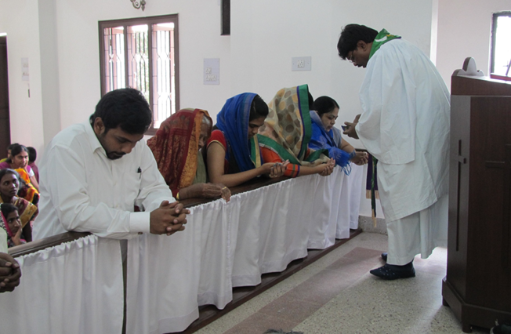
Holy Communion at Hyderabad in the Lutheran Mission of Salvation - India.

Slide 13
The women’s heads are covered by the pallu, the decorative loose end of a sari which women drape over their head and shoulders in church services as sign of respect and submission to God and so, according to conservative Indian culture, they “worship God acceptably with reverence and awe (Hebrews 12).”

Slide 14
What is the significance of the Lord’s Supper in my life?
In the Sacrament of the Altar, we receive not merely a reminder of forgiveness for our sin, but, along with the body and blood Christ sacrificed for us, actual forgiveness itself.

Slide 15
Together with our fellow-Christians, we confess our sins on Sunday, and receive the Lord’s Supper.
What are three “unions” that exist in the Sacrament we call “Holy Communion?”

Slide 16
What are ways in which Christians prepare for the Sacrament of the Altar?

