Slide 1

Let’s Talk About…
An Online Bible Study

Slide 2
All Because of Easter!

Slide 3

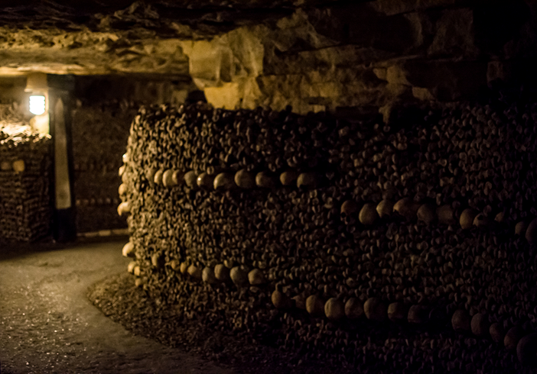

Slide 4
OK, this is a little creepy. The catacombs at the San Francisco de Asis Convent in Lima, Peru form an underground cemetery beneath the historic center of the capital city.

Slide 5
Subterranean halls tunnel outward to recesses lined with human bones and skulls, some displayed in religious designs. Over 25,000 people, commoners as well as famous figures, are buried within its vaults, many in deep wells filled with bones which were thought to serve as shock absorbers during earthquakes. This is the largest catacomb site in South America and the second-largest in the world.

Slide 6
The largest underground ossuary is in Paris. Descend a spiral staircase to the dark catacombs beneath the City of Lights and a sign warns: “Arreste! . . .” (“Stop! You are about to enter the empire of the dead”). Millions are believed to be buried in a web of mineshafts, converted to the purpose when the cemeteries were filled.

Slide 7
The Gothic church building in Sedlec, Czechia has a very unimpressive exterior. Inside, things get interesting: its walls are decorated with skulls and bones; there is even a chandelier made from at least one of every bone in the human body.
In narrow passageways carved from stone beneath the Pechersk Lavra (“Monastery of the Caves”) in Kiev, Ukraine, more than 100 religious and political figures are entombed.

Slide 8
Visiting these macabre sites prompted me to think of the day of resurrection, when God will reassemble our bodies and bring them back to glorified life by reuniting them with our souls for eternity with him in heaven. St. John wrote “Blessed are the dead who die in the Lord from now on (Revelation 14).”

Slide 9
Why? Because of Easter! We say with Job, “I know that my Redeemer lives, and that in the end he will stand upon the earth. And after my skin has been destroyed, yet in my flesh I will see God (Job 19).” Again, why? Again, because of Easter! Jesus promises “Because I live, you also will live (John 14).”

Slide 10
How does Christ’s resurrection from the dead prove that he is God’s Son?
That he made full satisfaction for our sin?
That we will rise again on the last day?

Slide 11
Why are these points usually part of both an Easter worship service and a Christian funeral sermon?

Slide 12
St. Paul wrote that “as many of us were baptized into Christ Jesus were baptized into his death (Romans 6).”
How does Jesus’ promise that “Because I live, you will live also (John 14)” tie together Christ’s redemption, our connection to him in baptism, and our eternal life in heaven?

Slide 13
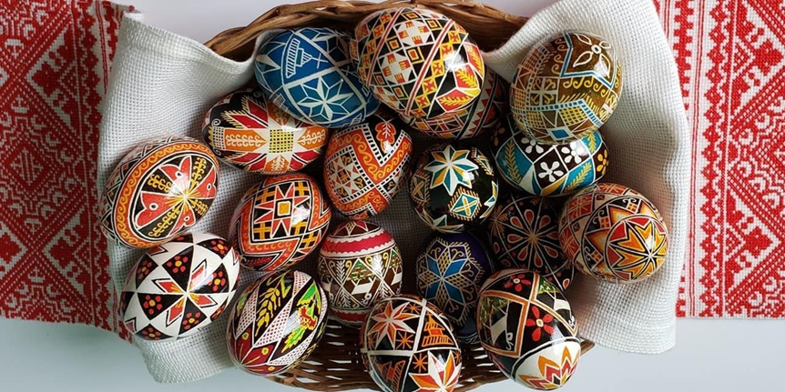

Slide 14
Centuries ago the Ukrainian art of egg decorating (pysanky) celebrated the end of winter and nature’s rebirth in springtime. Eventually the custom was Christianized and for the faithful today the painted Easter eggs symbolize the resurrection of Christ and the promise of new life after death for believers. Celebrating Easter . . . on and on!

Slide 15
’Tis the spring of souls today; Christ has burst His prison.
And from three days’ sleep in death As a sun hath risen.
Evangelical Lutheran Hymnary, #347

Slide 16
What is my favorite Easter custom?
What is my most precious Easter memory?

Slide 17
What are the most meaningful aspects of the Lenten Holy Week and Easter worship services at our church?

Slide 18
What symbols does our congregation use in celebration of Easter?

