Slide 1

Let’s Talk About…
An Online Bible Study

Slide 2
The World Wide Harvest

Slide 3
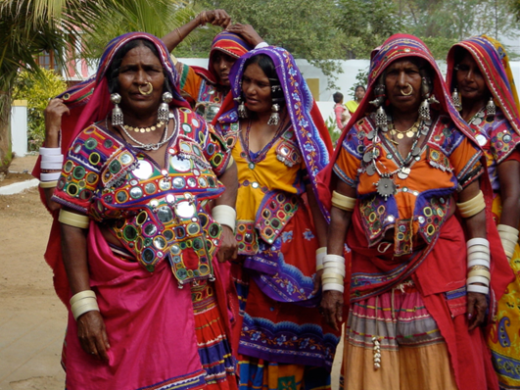

Slide 4
Did you know that the churches we support as “world missions” conduct Gospel ministry in places they consider their own fields “ripe for harvest (John 4)?” It is true! In India, the Lutheran Mission of Salvation-India conducts ministry among people they call “tribals” in remote communities.

Slide 5
In Peru, professors from the Lima seminary trained evangelists to bring the Christian doctrine to native communities in thatch-roof rainforest villages. In South Korea, pastors are learning to seek and minister to ethnic Koreans of Chinese citizenship.

Slide 6
Some people and places in the world may seem strange to us, but because the churches we support also “send out workers into his harvest field (Matthew 9),” God has extended his kingdom in surprising fashion as the faith-creating Gospel is shared with others.
Maybe it is surprising that Lutheran theology and the blessing of its clear Gospel message has come even into our own lives!

Slide 7
We celebrate the Reformation of the Church, which Martin Luther was led to conceive, sacrificed to bring about, prayed God to bless, and faithfully promoted in the face of personal persecution. At the center of the Reformation was Luther’s teaching on objective justification (salvation won by Christ for all) and subjective justification (salvation received personally through faith in Christ): “Although the work of redemption itself has been accomplished, it still cannot help and benefit a man unless he believes it . . . (Luther’s Works, SL10, 991).

Slide 8
We and the churches which we support are committed to Gospel outreach because “faith comes from hearing the message, and the message is heard through the word of Christ (Romans 10).”

Slide 9
“It is by grace you have been saved (objective or universal justification, accomplished by God in Christ), through faith (subjective or personal justification, received through faith in God’s promise) . . . (Ephesians 2).”
Why is this the Christian’s greatest comfort?

Slide 10
“It is by grace you have been saved (objective or universal justification, accomplished by God in Christ), through faith (subjective or personal justification, received through faith in God’s promise) . . . (Ephesians 2).”
What will we commit to doing so that others may have this comfort also?

Slide 11
Is mission work something that is only done in foreign countries?
Are there examples of such work among our congregation?

Slide 12
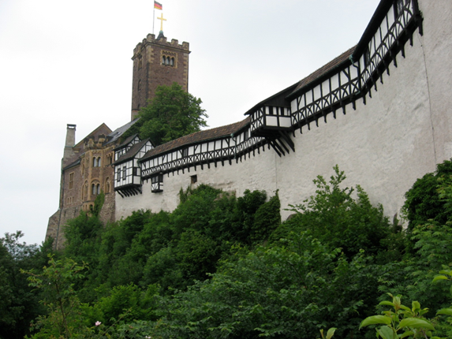
The Wartburg Castle was a shelter for Martin Luther when the enemies of the Reformation sought to stifle his efforts to re-awaken the Church to the Gospel of Jesus Christ.

Slide 13
Just think how the truths of the Lutheran Reformation have been spread by pastors, churchmen, and missionaries from Germany in Luther’s day to mission fields world-wide and even to our communities and our lives today.

Slide 14
What does it mean to me that Reformation truths are part of my own life?

Slide 15
How might my life (now and in eternity) be very different if I had not learned the truth about salvation in Christ?

Slide 16
My congregation celebrates the Reformation each October. That’s good. Why can this not be the only time when we stop to appreciate the central precepts of our faith (sola gratia, sola fide, sola Scriptura)?

Slide 17
How can we incorporate “grace alone, faith alone, Scripture alone” into our church-life more regularly?

Slide 18
Luther wrote, “Nothing more is required for justification than to hear of Jesus Christ and to believe on Him as our Savior (SL 12, 208).” Through faith sinners possess personally the blessings Christ won for all with his life, death and resurrection.
How do we celebrate the Gospel every day?

