Slide 1
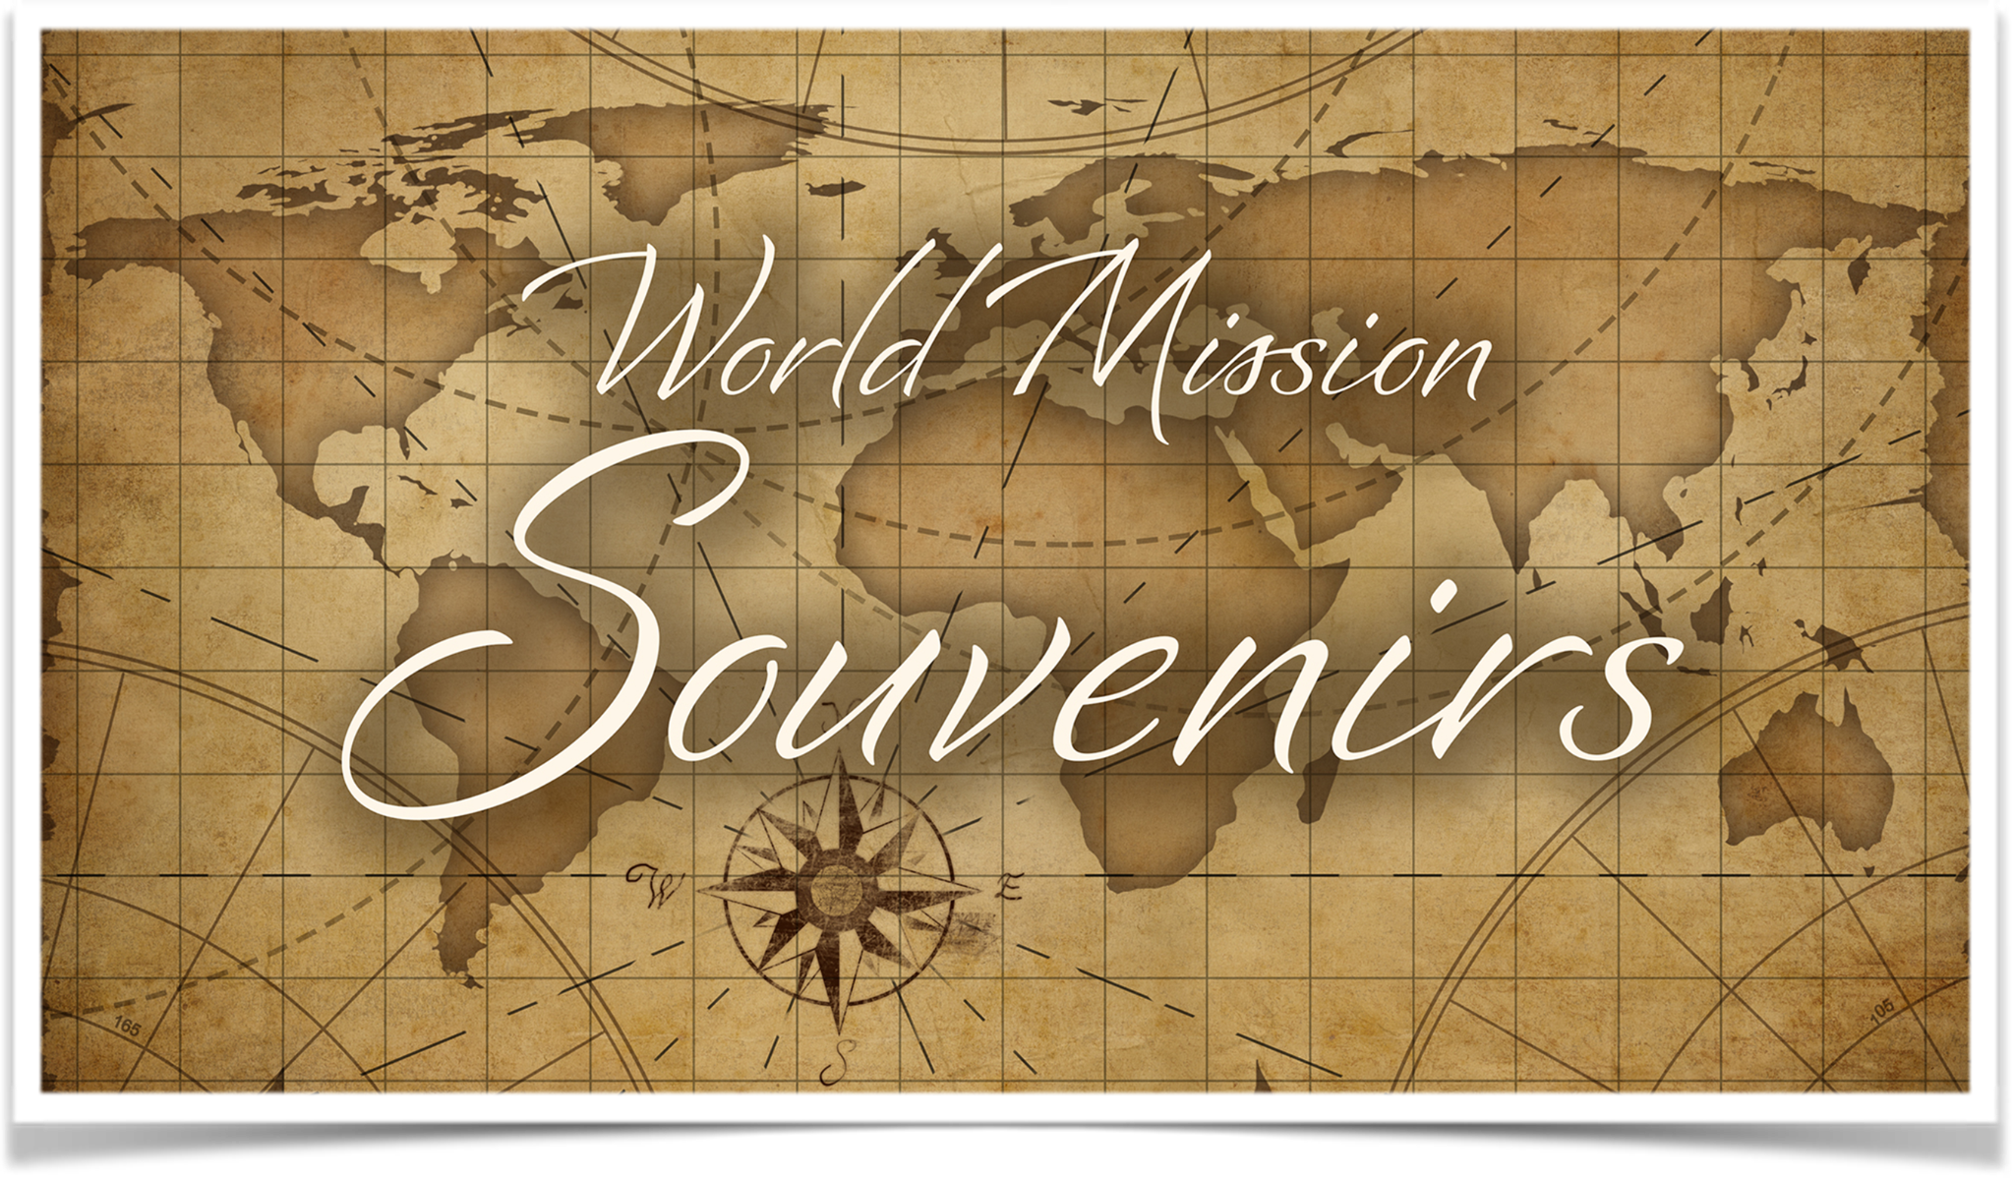
Let’s Talk About…
An Online Bible Study

Slide 2
Mission Trails

Slide 3
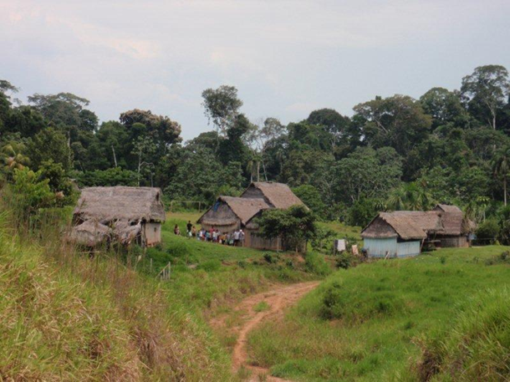

Slide 4
Missionaries follow a trail. Tarapoto, Peru lies in the foothills of the Andes Mountains which rise to its west, and it serves as a departure point for excursions into the wilds of the Amazon Basin to the east. Here’s how, years ago, the Gospel made its way to this remote place, and beyond.

Slide 5
Lydia Soplin traveled from Tarapoto to Lima in search of employment. She learned about Jesus from ELS missionaries there, became a Christian, and then encouraged the missionaries to bring the Gospel to her family back in Tarapoto. Traveling there, they were welcomed by Lydia’s aunt, Nellie. Also found: Ramon and Soccorro, customers at the sidewalk cafe Nellie operated in front of her home where she sold skewers of roasted pork, chicken, and plantains to her neighbors.

Slide 6
Ramon’s original home was the Huallaga River town of Pelejo, and in time missionaries carried the Gospel to that thatch-roof village. It became the headquarters for ELS mission work in the rainforest.

Slide 7
Eventually Peruvian missionaries began to travel the rainforest rivers in dugout canoes to bring the Gospel to even more remote jungle villages (World Mission Souvenir, ca 2012).

Slide 8
Did you note the trail the missionaries followed? Lydia — to Nellie — to Ramon and Socorro — to the river village of Pelejo — then deeper into the rainforest beneath its lush green canopy.

Slide 9
The Gospel moves forward and outward on its mission, following the pattern of the early church: “In this way the word of the Lord spread widely and grew in power (Acts 19).” Final results of the Gospel’s advance? They must be left in God’s hands, and not always as we might wish, but we know many blessings are received by all who learn of Christ, our Savior!

Slide 10
How was I first reached with the gospel?
How can I share my faith with others?
Who was responsible?

Slide 11
“Everyone who calls on the name of the Lord will be saved.” So Paul asks, “how can they call on then they have not believed in? And how can they believe in the one of whom they have not heard (Romans 10)?”
What is the Christian’s motivation for evangelism, for sharing the Gospel of Jesus?

Slide 12
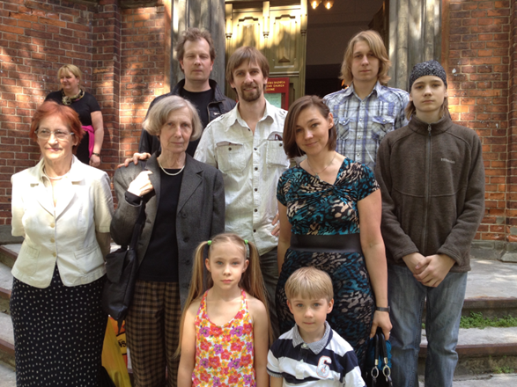

Slide 13
Ruta (2nd from left) searched for a church faithful to the Scriptures in Riga, Latvia. When she found the Confessional Lutheran Church of Latvia, she happily became a member of the congregation. One by one, she invited family members and friends to join with her. Pictured with her are those she reached!

Slide 14
The missionaries’ trail in Peru and Ruta’s evangelism in Latvia are both examples of what is sometimes called FRAN evangelism sharing our faith Christ with Friends, Relatives, Associates and Neighbors or inviting them to worship).

Slide 15
How can our congregation assist in reaching out to people within the sphere of my influence with the Gospel?

Slide 16
Read Mark 4:26-29. The seed is the Gospel. The sower is us as we reach out to FRANs.
What should we do if we’re not seeing results to our sowing?

Slide 17
Describe a time when you have seen a harvest.
Describe what will be the ultimate harvest.

Slide 18
“But you are a chosen people, a royal priesthood, a holy nation, a people belonging to God, that you may declare the praises of him who called you out of darkness into his marvelous light (I Peter 2).”
How is this passage the basis for the “priesthood of all believers?”

Slide 19
“But you are a chosen people . . . declare the praises of him who called you out of darkness into his marvelous light (I Peter 2).” What’s the darkness? What’s the light?
What are the implications of this doctrine?

