Slide 1

Let’s Talk About…
An Online Bible Study

Slide 2
He Broke the Coconut

Slide 3
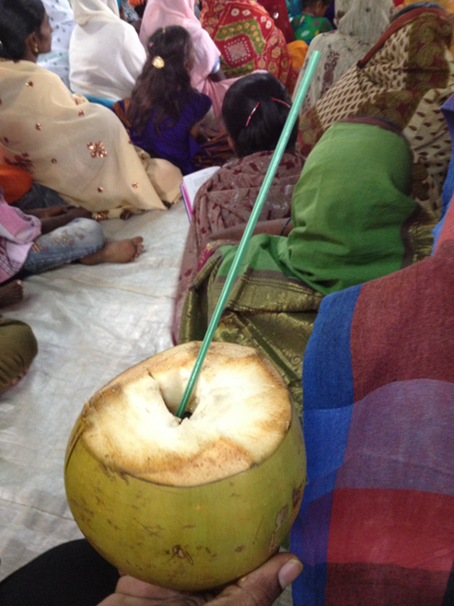

Slide 4
“He broke the coconut!” an Indian pastor said in disgust. He was referring to a former fellow-pastor who had blatantly abandoned the Lutheran practice of church fellowship. The man was running for public office, and while campaigning in a Hindu community, “He broke the coconut!”

Slide 5
Among Hindus, the coconut is a sacred fruit. To break one open during a worship service (like a wedding) or in a special event (like ground-breaking for a house construction) is to acknowledge that one’s prideful ego must be broken and one must humbly submit to a particular Hindu god. For a Christian pastor to perform such a ritual publicly is a practical denial of allegiance to the one true Triune God, and an acceptance of one or more of the myriad false Hindu deities.

Slide 6
Coconut juice is commonly thought to possess a cooling quality for a human body on a hot day. So sipping from a coconut broken with a machete is perfectly acceptable. Same action, different context and meaning.

Slide 7
Christians are careful so that their behavior does not send confusing signals about the faith. We must resist the temptation to deny our Savior by the way we act or speak. Holy Scripture clearly reminds to repent of all sin. Seeing again the faithfulness of our Savior despite his suffering is a sharp rebuke for our failing.

Slide 8
But still we can sing, “Thou hast not left me, oft as I left Thee. On to the close, O Lord, abide with me.” (Evangelical Lutheran Hymnary, #561) because God promises us that “if we confess our sins, he is faithful and just and will forgive our sins and purify us from all unrighteousness (I John 1).”

Slide 9
Paul’s instructions for pastors: “Guard yourselves and all the flock of which the Holy Spirit has made you overseers. Be shepherd of the church of God, which he bought with his own blood (Acts 28).”
What are the various elements of faithful pastoral ministry identified in these words?

Slide 10
Since Jesus warned his followers about causing offense by unfaithfulness in ministry (“millstone hung around his neck (Matthew 6),” what the high expectations for those who preach and teach in the congregation?

Slide 11
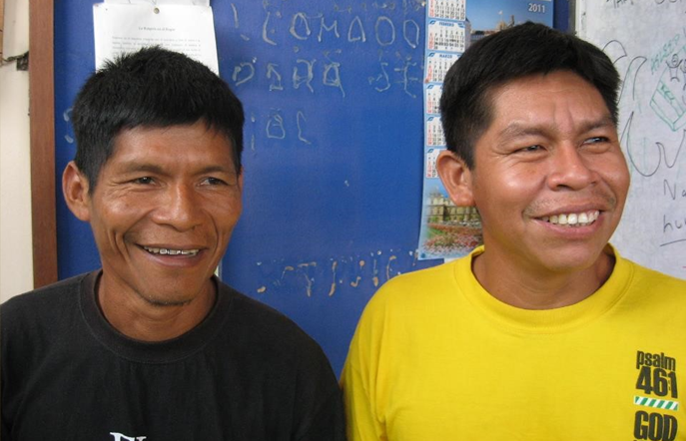

Slide 12
Jungle evangelists, Maribi and German, sometimes traveled by dugout canoes to remote thatch-roof villages in the Peruvian rainforest. Often they relied on family connections to make their introductions to strangers so they could share the Gospel.

Slide 13
They were following St. Paul’s instructions: “And the things you have heard me say in the presence of many witnesses entrust to reliable men who will also be qualified to teach others (2 Timothy 2).” Maribi was once offered significant financial support from a non-denominational sect to serve in its ministry. He declined, saying that he was committed to remaining a servant in the Lutheran Church.

Slide 14
What is the most important personal service a pastor provided to me?

Slide 15
How does our congregation support our pastor’s ministry and/or encourage him?
How can we do better?

Slide 16
What assistance to pastoral ministry can laymen give?

Slide 17
We admire Maribi’s commitment to our Lutheran faith and fellowship.
What might tempt a pastor to “break the coconut,” that is, to be unfaithful to his calling in dealing with prospects for the church or in dealing with non-members at church services like weddings, baptisms, etc.?

Slide 18
“Now it is required that those who have been given a trust must prove faithful (I Corinthians 4).”
What are the implications of this for public ministry?

