Slide 1

Let’s Talk About…
An Online Bible Study

Slide 2
Virgin Mary and Buddha

Slide 3
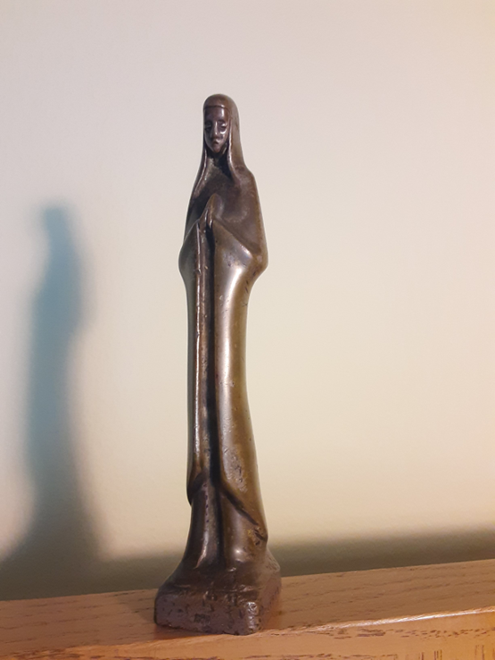
This World Mission Souvenir is a five-inch statuette of the Virgin Mary, purchased at a second-hand shop in Lima, Peru.

Slide 4
Its original home and how it was used - who knows? What we do know is that the Roman Catholic Church is predominant in Latin cultures, and in Roman theology the Virgin Mary plays an outsized, unwarranted role. One false teaching about Mary is the notion that she was sinless, the result of her own “Immaculate Conception.”

Slide 5
While we reject unscriptural notions, still we honor the Virgin Mary and her humble service to the Savior. The Christian Church customarily observes Annunciation Day each year on March 25, nine months before Christmas Day. It’s a celebration of the angel Gabriel’s announcement to Mary that she would conceive and become the mother of the Son of God in human flesh, marking his Incarnation.

Slide 6
Gabriel told Mary to name her son Jesus, meaning “Savior.” And she herself humbly and honestly identifies both her need for forgiveness and her trust in her son to be her Redeemer. In the words of Mary’s Song, the Magnificat, she refers to God’s promise to send the Messiah; she sang: “my spirit rejoices in God my Savior . . . (Luke 1).”

Slide 7
“True God and yet a Man?
True maid and yet a mother?
Thought wonders how thought can conceive one or the other.”
- Evangelical Lutheran Hymnary, #269

Slide 8
“All steeples point to heaven.” Maybe so, but does that mean every religion saves sinners?

Slide 9
How does our congregation ensure that we focus on “God my Savior” instead of “self-righteousness” (thinking our works are the basis of salvation)?

Slide 10
How is it possible that the Virgin Mary, one of Christianity’s central and most honored figures, be misunderstood?

Slide 11
It is only natural to assume that Christ’s mother could influence him, but what danger lurks within that kind of thinking?

Slide 12
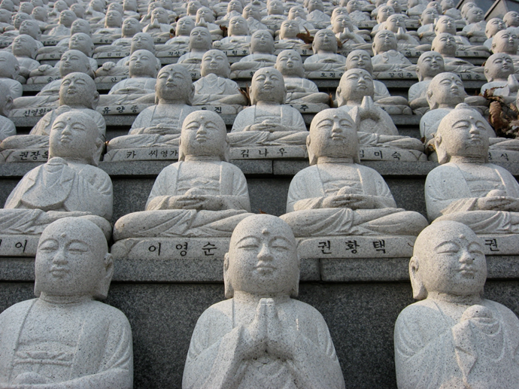
In South Korea today there are more Christians (about 1/3 of the population) than Buddhists (about 20%). Still the influence of Buddhism remains, evidenced in this wall of statues at Seoul National Cemetery.

Slide 13
Confessional Lutheran pastors bring Koreans the Good News of Christ’s sinless life, innocent death and victorious resurrection as the basis for salvation and eternal hope. “. . . no other name under heaven . . . (Acts 4).”

Slide 14
God has protected me from falling into worship of false gods.
How can I show gratitude for this grace?
What temptations exist?

Slide 15
In Buddhism, nirvana is reached through enlightenment, the goal of which is the extinguishing of worldly interests by living a moral life.
Is this possible for people like us?
Why or why not?

Slide 16
What can we learn from the Virgin Mary’s acknowledgement of her own sinfulness?

Slide 17
What are the powerful implications of “. . . all have sinned and fall short of the glory of God, and are justified freely by his grace through the redemption that came by Christ Jesus (Romans 3)?”

Slide 18
Someone described evangelism as “One beggar telling another beggar where to find bread.”
The beggars?
The bread?
The Good News about Jesus can be heard or read!

Slide 19
Consider how God blesses our efforts to reach out to others, showing kindness to them, that we might also tell them of Christ’s sinless life as their representative before God, his death at the cross as our willing substitute for their sin, and his resurrection as proof that God accepted what Jesus did to save us.

