Slide 1

Let’s Talk About…
An Online Bible Study

Slide 2
God Bless Our School!
Notes:
9:53

Slide 3
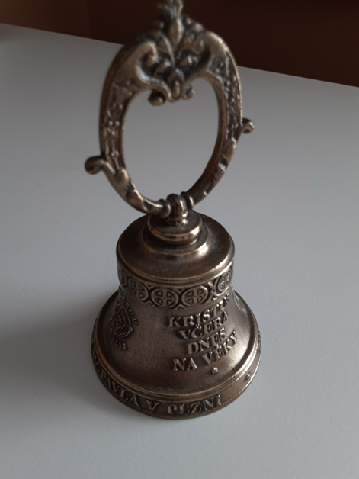

Slide 4
This small brass bell was a gift, a souvenir from the St. Paul Lutheran Congregation and Martin Luther School in Plzen, Czechia (formerly Czech Republic). The congregation and school with its student body of 200+ share a renovated space which years before housed a public school.

Slide 5
The building survived WW2, and today it features a chapel, eight classrooms and four apartments. Rev. Martin Vrsecky serves the congregation and manages Martin Luther School. The school is highly regarded in the Plzen community as it features English-language education in addition to Lutheran theology.

Slide 6
Of course school bells ring out around the world each fall, but this is one school bell which uniquely resonates with a true spiritual significance. Inscribed on its surface are messages we would wish all students to learn: “Christ yesterday, today, and tomorrow (Hebrews 13)” and “your Word is true (John 17).” We thank God for every Lutheran Elementary School, every Sunday School, and every educational program where Christ is proclaimed.

Slide 7
My best childhood Sunday School/Christian Day School memory?
The teacher?

Slide 8
Jesus instructed us to “make disciples of all nations . . . teaching them to obey everything I have commanded you (Matthew 28).”
How does the progression of doctrine in Martin Luther’s Small Catechism (Six chief parts: the Law of God, the Apostles’ Creed, The Lord’s Prayer, Baptism, the Office of the Keys, and The Lord’s Supper) aid in teaching the Christian faith?

Slide 9
Do these teachings confirm the message on the bell?

Slide 10
Would you add anything to Luther’s format?

Slide 11
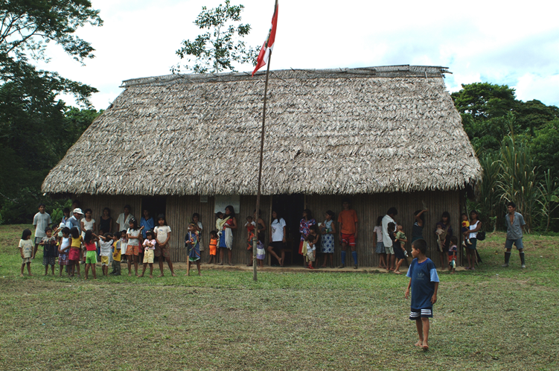
Children must be educated! In the Peruvian rainforest, this school was established for the village of Nueva Barranquita. Secular and spiritual classes comprise the curriculum.

Slide 12
List the various Christian education programs offered by our congregation.

Slide 13
What could we do to enhance our community’s understanding of our educational program?
What could we do to increase participation?

Slide 14
Martin Luther School in Plzen has the latest in computer technology. There is nothing like that in the jungle school.
What’s most important?

Slide 15
God’s Old Testament covenant (He is our God, we are his people - with all that both parts of the covenant imply) defines our relationship with him. Through Moses he says of the instructions he gives, “Impress them on your children (Deuteronomy 6).”

Slide 16
How do parents, congregations and church bodies impress on children that God’s Word is true?
How do we do that in World Missions?

