Slide 1

Let’s Talk About…
An Online Bible Study

Slide 2
Prayer

Slide 3
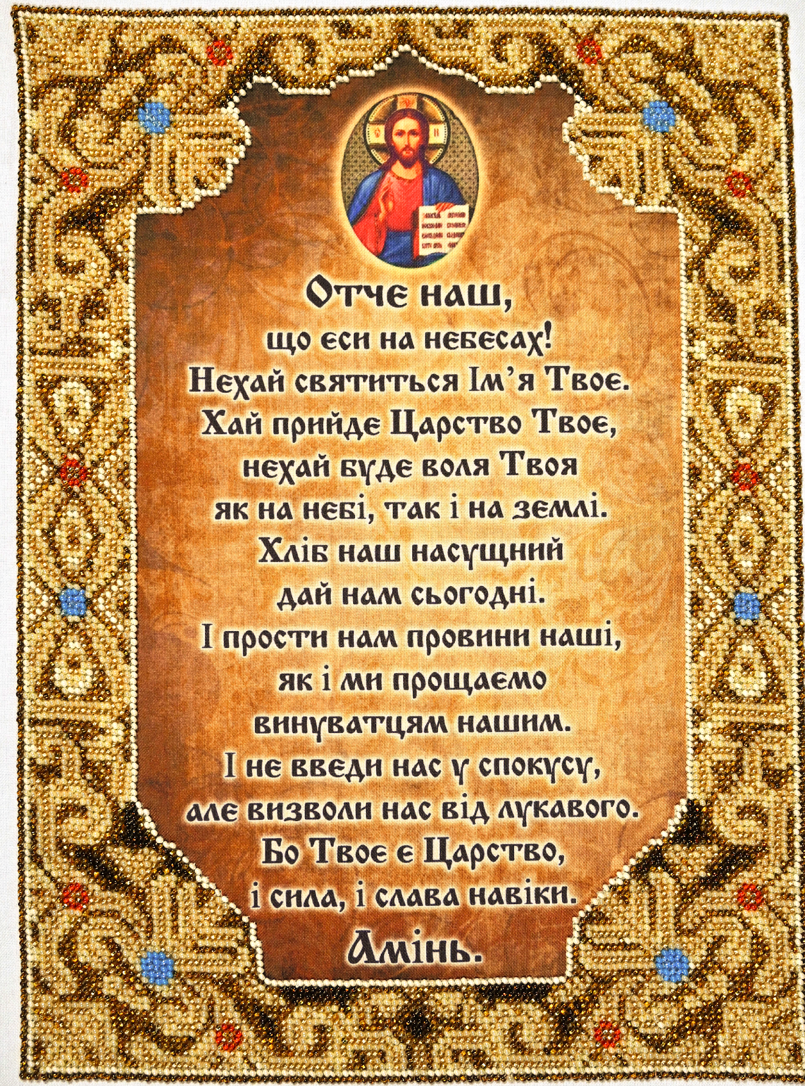

Slide 4
This World Mission Souvenir is an embroidered Lord’s Prayer in Ukrainian. Among Christians, the language in which it is offered is not as important as the trusting heart that offers it to our loving Lord.

Slide 5
This prayer is universal, and for good reason: the corporate nature of the prayer, the “we’re all in this together” sense it conveys. We see that in the plural pronouns: “our Father,” “our daily bread,” “our trespasses.”

Slide 6
As the world’s creator, God is Father to all that exists - all he made is found beneath his governing hand. As the creator of the holy Christian Church, God is Father to the family of believers - so we are found also within God’s loving heart. St. Paul calls Christians the “household of God (Ephesians 2).” We were granted our place there when the Holy Spirit brought us to faith in our Savior, Jesus Christ. Paul assures us “You are all the children of God by faith in Christ Jesus (Galatians 3).” What a blessing to be at home in the household of Our Father!

Slide 7
The Lord’s Prayer includes a specific prayer for missions: “Thy kingdom come.” Christian pastors, missionaries and witnesses bring the saving Gospel of Jesus to the fields where they serve, so that hearts in Ukraine and world-wide may join with us in prayer to Our Father. It is our privilege, regardless of location or language, to pray God’s blessing on his growing kingdom.

Slide 8
Six of the seven petitions in the Lord’s Prayer focus on spiritual matters, only one on material things.
What does this tell us about what “Our Father” wishes for us?

Slide 9
When we pray “Thy kingdom come,” we are praying that we might be found in God’s Kingdom of Grace, that others may join us, and that we all are brought safely to heaven.
How is this a prayer for missions?

Slide 10
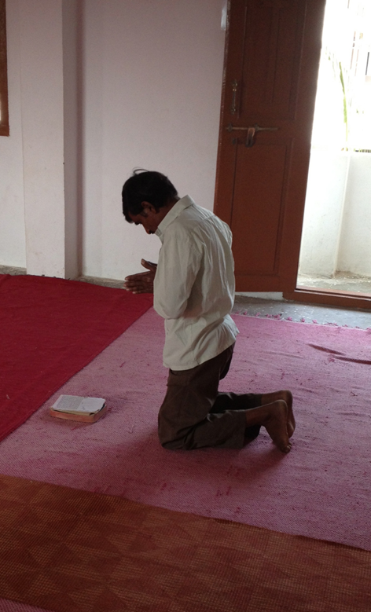
Prayerfully preparing for Sunday morning worship service at St. Peter’s Lutheran Church in Hyderabad, India.

Slide 11
What was the first prayer I learned?
Who taught me?
Do I have a favorite prayer?
Do I still pray it?

Slide 12
What is my favorite posture for prayer?
Do I have a favorite place and time to pray?

Slide 13
The “Collects” in our liturgy are prayers.
As our congregation cycles through the Church year, how do these prayers develop/enhance our worship service?

