Slide 1

Let’s Talk About…
An Online Bible Study

Slide 2
Commitment to Lutheran Ministry

Slide 3
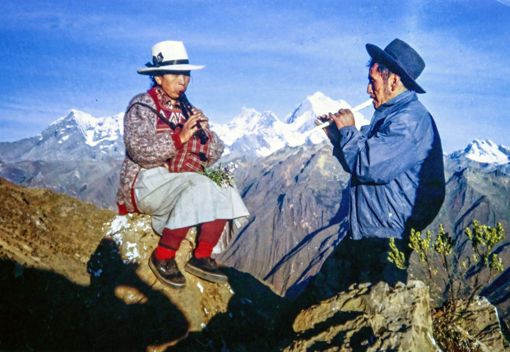

Slide 4
Fidel Conversio studied for 18 years to become a Lutheran pastor in Peru. Yes, you could say he was a persistent student! Why such a lengthy period of study? He lived with his family in a high Andes Mountain village of Paillon and traveled from there to the seminary in Lima only as he could afford to leave his employment and commit time to his education.

Slide 5
In 1992 Fidel and two other men became the first ordained Lutheran pastors trained by the Evangelical Lutheran Synod in Peru. In the World Mission Souvenir photo, Fidel and his wife Dora are seen near the Andes village where he served as pastor until his death in 2024.

Slide 6
What prompts such commitment to pastoral ministry? Of course it is the Gospel of Jesus Christ. Fidel remarked once that before he became a Christian he lived in fear - fear of the vagaries of life, fear of uncertainty after death. Learning to know Jesus, he wanted to share the comfort and confidence of his faith with others.

Slide 7
Our pastors do the same today, following St. Paul’s words: “. . . God. . . reconciled us to himself through Christ and gave us the ministry of reconciliation: that God was reconciling the world unto himself in Christ, not counting men’s sins against them (2 Corinthians 5).”
We pray for our pastors, and it is appropriate every day to recognize and thank those who serve us: preaching, teaching, counseling, comforting - from our pulpits, at our altars, in our homes.

Slide 8
As Fidel Conversio studied for ministry year after year, what role did his wife Dora play in that effort?

Slide 9
How is your pastor’s wife a blessing to the congregation?
How can we appreciate our pastors’ wives better?

Slide 10
What special challenges do pastors’ families face?

Slide 11
What is the clearest evidence you see demonstrating your pastor’s faithfulness and dedication?

Slide 12
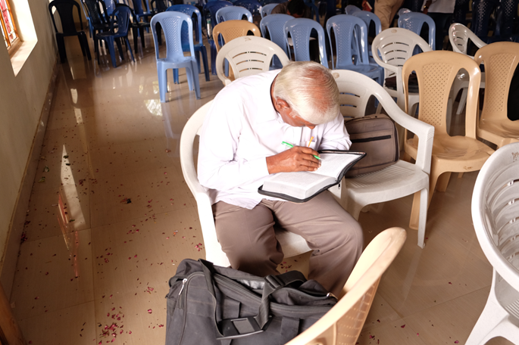

Slide 13
Gospel Workers are laymen in various stages of training for ministry in the Lutheran Mission of Salvation - India (LMSI). They gather monthly to study God’s Word in preparation for service in the Church. St. Paul instructed Timothy: “And the things you have heard me say in the presence of many witnesses entrust to reliable people who will also be qualified to teach others (2 Timothy 2:2).”

Slide 14
Why is it important to me that my pastor is well-trained in God’s Word?

Slide 15
Pastors study at the Seminary to be trained to serve in the Church.
How does this training continue?
What can we do to support our pastor’s effort to grow spiritually?

Slide 16
Pastors study at the Seminary to be trained to serve in the Church.
What can we do to support the training of others for ministry?

Slide 17
Paul instructed Titus “to appoint (or ordain) elders in every town, as I directed you (Titus 1).” He continues saying that these men are to be “overseers (or bishops)” responsible for the ministry in congregations.
What are the primary responsibilities of those who serve in the pastoral ministry?

Slide 18
How can laymen also serve and contribute to their congregation’s ministry?

