Slide 1

Let’s Talk About…
An Online Bible Study

Slide 2
Jesus Only

Slide 3
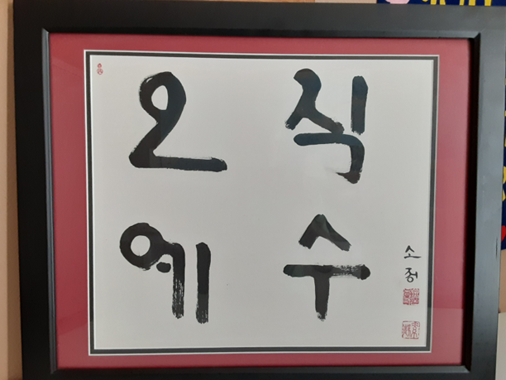

Slide 4
In Naju-city, South Korea, a shopkeeper-craftsman made frames for his brother’s art in a workshop cluttered with easels stretching painted canvases. The brother-artist produced traditional Korean scenes, mostly mist-covered mountains and quiet streams flowing among groves of lotus trees.

Slide 5
Each scene is complemented with poetry printed in stylized calligraphy. The artist is well-known and his art is expensive. The value of the paintings reflect their serenity and beauty, their sense of balance - and the fact that each is one-of-a-kind. Nobody else has a painting exactly like this one!

Slide 6
During a visit with the frame-making shopkeeper I mentioned a phrase that I had seen on a plaque inside a church. He told me that the expression was popular among Korean Presbyterians, and printed it out on newsprint in Korean characters using thick black brushes. We made a deal for a more well-finished copy. The next day I returned to the shop and was presented with a sheet of heavy paper on which these Korean characters were displayed: 오직 예수. Translation: “Jesus only.”

Slide 7
That sheet of paper became a souvenir eventually framed and mounted on our living room wall. The sentiment is appropriate among Christians, who sing “Jesus, Jesus, Only Jesus.”
- Evangelical Lutheran Hymnary, #379

Slide 8
Christians appreciate the uniqueness of Jesus Christ. “Salvation is found in no one else, for there is no other name under heaven given to men by which we must be saved (Acts 4).”

Slide 9
What spiritual message does our congregation’s sign or logo present to our community?

Slide 10
How might we make a clearer or more profound statement of faith?

Slide 11
Paul noted that Christians convey messages by their lives and witness, “You show that you are a letter from Christ (2 Corinthians 3).”
What message do you proclaim?

Slide 12
We sing, “Jesus, Jesus, Only Jesus.” (Evangelical Lutheran Hymnary, #379) The phrase “Jesus only” reveals the intimacy of the Christian’s relationship with the Savior through faith. It also reveals the exclusivity of the Gospel. Scripture reveals two truths: the Good News is meant for all, as “God was in Christ reconciling the world unto himself (2 Corinthians 5)” and also “there is no other name (Acts 4)” but Christ as Savior.

Slide 13
How do these truths fit together?
How might these truths be expressed in one sentence?

Slide 14
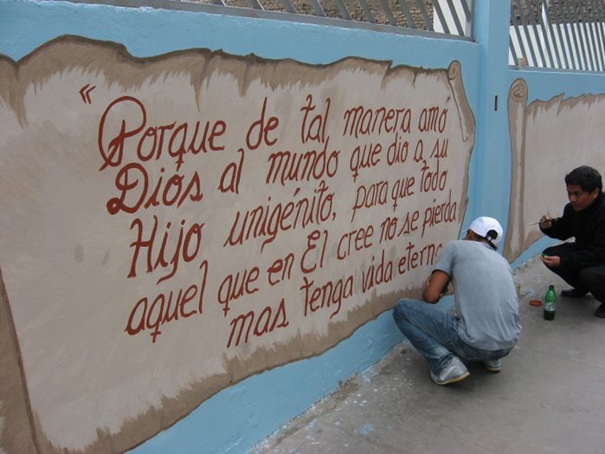
The outer wall of the Evangelical Lutheran Seminary in Lima, Peru. Passers-by read John 3:16, “For God so loved the world that he gave his only begotten Son, that whoever believes in him shall not perish but have eternal life.”

Slide 15
Was John 3:16 the first Bible passage I learned?
If not, which one was?
My other Sunday School favorites?

Slide 16
In what ways are the simple verses we learned as children the most important Scriptures for us?

Slide 17
John 3:16 is sometimes called “The Gospel in a nutshell.”
Why might we say that this passage proclaims exactly, and everything, we need to know to be saved?

