Slide 1

Let’s Talk About…
An Online Bible Study

Slide 2
The Pastor and the Paper Picker

Slide 3
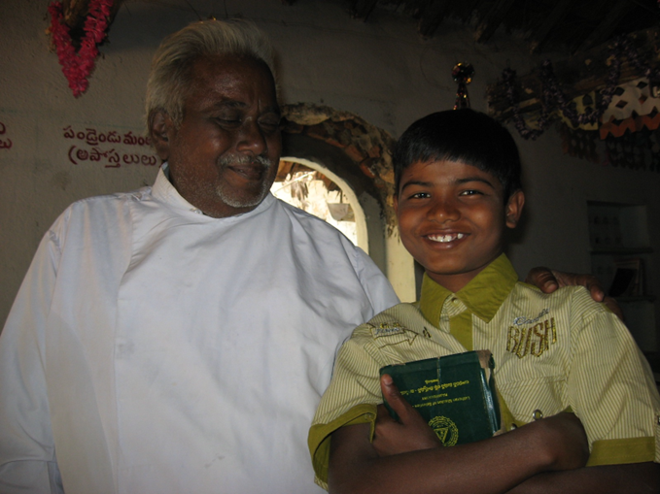

Slide 4
Pastor Watson served a small Lutheran congregation in a thatch-roof village in India. After a chicken and rice lunch cooked over an open fire and served on freshly-cut banana leaves, we met the young man in this World Mission Souvenir photo.

Slide 5
He was cared for in the orphan home managed by the Pastor and his daughter. Perhaps the boy’s parents were deceased, or they may have been too ill or too impoverished to care for him. In any event, the boy found himself on his own and supported himself by picking and selling scraps of paper and other recyclables. Taken into Watson’s home, cared for there, he learned about Jesus.

Slide 6
We have Biblical examples of Christians caring for others. In the Early Church, they “gave to anyone as he had need (Acts 2).” Sharing is part of our Sanctification, the loving acts and attitudes which are the natural result of our Justification, the fact that God has declared us “not guilty” in Christ.

Slide 7
Thank God our children and grandchildren are spared the difficulties that children in poverty and danger face everyday around the world. We thank him also that there are people who care for those in need. Our role? It starts with awareness of and empathy for the troubles others face, and prayer for God’s blessing.

Slide 8
It proceeds from there to helping with our own resources as we are able. Christian charity reflects gratitude for God’s mercy and grace in our own lives. “We love because he first loved us (I John 4:19).”

Slide 9
What is my fondest memory of an act of kindness shown to me?

Slide 10
How do the doctrines of justification and sanctification relate to one another?
How does justification move us to deeds of sanctification?
How do we know what acts of kindness we should do?

Slide 11
How might the difficulties others face really be opportunities God intends to us as opportunities for us to do good to others?

Slide 12
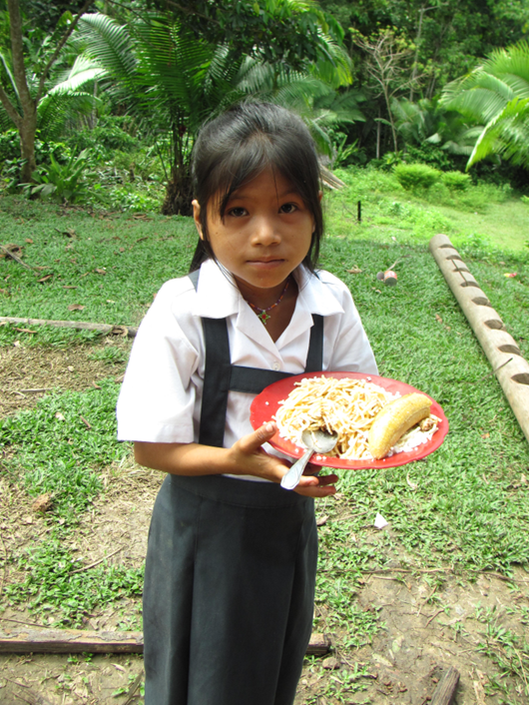
In the Peruvian rainforest meals are provided by the government for children in public schools. The children in schools operated by Christians must be fed by the schools’ sponsors. So, supporting Christian education in the jungle provides both for body and soul!

Slide 13
In what ways does our family and/or congregation shows the love of Christ to our community?
How can we learn to do better?

Slide 14
Do we need to look far to find people who need our help?
How can we share bread, and Jesus, “The Bread of Life (John 6)?”

Slide 15
St. James (2) asks “What good is it, my brothers and sisters, if someone claims to have faith but has no deeds?
Can such faith save them?”

Slide 16
And “Suppose a brother or a sister is without clothes and daily food. If one of you says to them, ‘Go in peace; keep warm and well fed,’ but does nothing about their physical needs, what good is it?”

Slide 17
James concludes, “In the same way, faith by itself, if it is not accompanied by action, is dead..”
What practical lessons do we learn from St. James?

