Slide 1

Let’s Talk About…
An Online Bible Study

Slide 2
Prayer

Slide 3
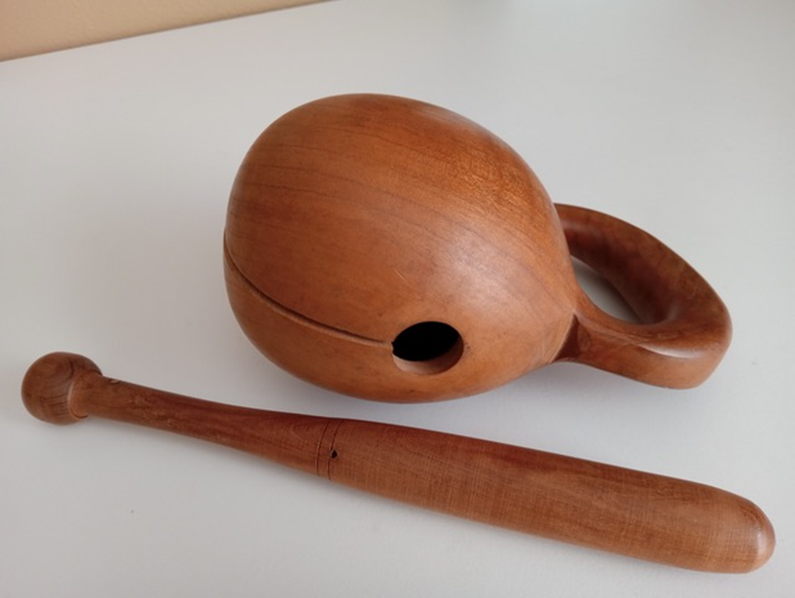

Slide 4
Generally, only percussion instruments are heard in Buddhist temples as monks sit cross-legged before a bank of shiny gold Buddha busts and chant their sutras (statements of Buddhist principles) during worship. Quite common for accompaniment is the moktak, a hand-held gong made of hollowed wood, struck with a wooden mallet.

Slide 5
The moktak is usually carved into the stylized shape of a fish (can you see it in the World Mission Souvenir?) and is struck as the monks recite their sutras. The theory seems to be that just as the fish doesn’t sleep, so the relentless rhythm of the hollow knocking instills wakefulness in prayer for the devout Buddhist.

Slide 6
We sing, “Take it to the Lord in prayer!” (Evangelical Lutheran Hymnary, #385). It often seems that our prayer-life is more active and intense during times of trial, when our needs and problems become close companions. Then again, too often, in times of prosperity and happiness, we are tempted to neglect to offer a prayer of thanksgiving. That seems to be the reality of our human nature.

Slide 7
We Christians should not need the hollow knocking sound of the moktak for motivation to pray. In fact, among many Scripture verses, two Psalms identify motivations for prayer. Our Heavenly Father invites us: “Call upon Me in the day of trouble; I will deliver you and you shall honor me (Psalm 50).” And He encourages us, “O give thanks to the Lord, for he is good; his love endures forever (Psalm 107).”

Slide 8
What is the first prayer I learned?
Who taught me?

Slide 9
Today, when am I most faithful in my prayer life?
What interferes with my prayer life?

Slide 10
The Buddhist moktak is intended as an aid to prayer. The prayers we have learned aid us in our devotional life because they touch on important subjects, for example, memorized prayers before meals, at the end of day.
But what dangers exist in these memorized prayers?

Slide 11
God invited Israel to “call upon” him in prayer when they suffered the consequences for their disobedience. He encouraged them to “give thanks” for the mercy he showed them. We see God’s mercy clearly in the Gospel, the Good News that Christ has delivered us from sin, death and hell by living and dying in our place.

Slide 12
In which words of the Lord’s Prayer do we “call upon” God and thank him for his “mercy?”

Slide 13
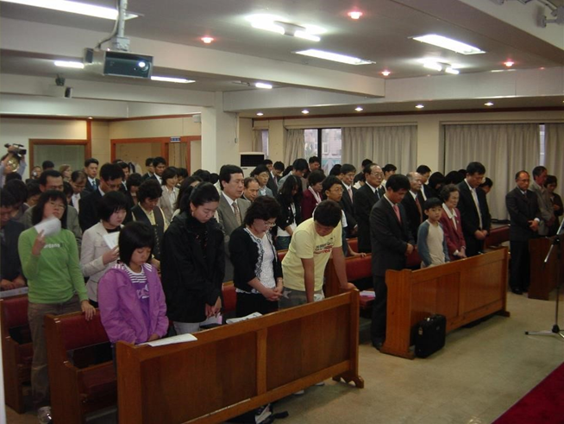
Heads bow in prayer among the congregation during the Sunday morning worship service at Seoul Lutheran Church. Some members continue to observe “Morning Prayer” daily at 5:30 am, an old custom among Korean Christians.

Slide 14
One of the most precious privileges of Christian life is joining with fellow Christians in prayer.
What distinctions exist between private and public liturgical prayer and between prayers spoken and prayers of the heart alone?

Slide 15
In I Thessalonians 5 Paul includes, “Pray continuously,” in his exhortations for Christian behavior.
What do we learn from Romans 8:26 about the the Holy Spirit’s assistance in our prayer-life?

Slide 16
What’s the best time to pray - morning, at mealtime, evening?

Slide 17
For what is it easiest to pray - relief from trouble, thanksgiving for blessings?

