Slide 1

Let’s Talk About…
An Online Bible Study

Slide 2
Your pastor wore shoes on the day he was Ordained. These pastors didn’t.

Slide 3
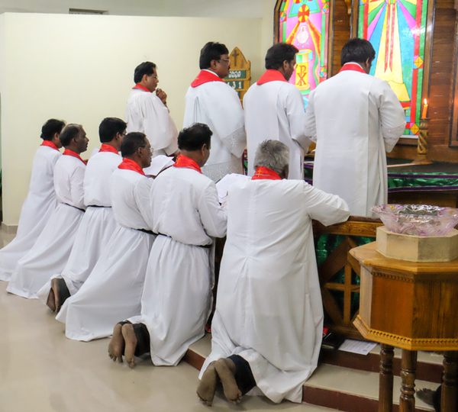

Slide 4
A group of six candidates was ordained at Rajahmundry in the Lutheran Mission of Salvation - India. As you can see in this World Mission Souvenir, among our Indian fellowship being barefoot (indoors as well as outdoors) is customary.

Slide 5
These men took up pastoral duties in locations ranging from noisy, congested cities to remote, rural villages (one of the new pastors crossed paths with a huge Bengal tiger lying across a roadway; “I saw him with my own eyes,” he said.)

Slide 6
It has become customary in our circles to observe October as Pastor Appreciation Month, a time for us to thank those who serve as shepherds among our congregations. Although most pastors in our country serve in quite civilized locations, ministry today is filled with its own challenges unique to our setting: cultural and philosophical opposition to Scriptural principles, challenges to marriage and home life, economic and time pressures on modern families, and more.

Slide 7
How is it then that men enter the ministry with hope, confidence, and commitment? The answer is found in the fact that God himself arranged for the public ministry of Word and Sacrament for his Church. Through the Church he Calls pastors to service, and promises to bless all who serve him. “Guard yourselves and all the flock of which the Holy Spirit has made you overseers. Be shepherds of the church of God, which he bought with his own blood (Acts 28).”

Slide 8
What is my best memory of my childhood pastor?

Slide 9
St. Paul, quoting the Prophet Isaiah (52) refers to the beautiful “feet of those who bring good news (Romans 10).”
What is the implication for mission work in India, Peru and around the world and pastoral ministry at home?

Slide 10
Servants of Christ “prepare God’s people for works of service, so that the body of Christ may be built up . . . (Ephesians 4).” Preparing Christians to serve in one part of the world might differ from doing that in the US - for example, in India men are strictly segregated from women’s homes, so “Bible Women” are employed to share the Word with their own gender. So being prepared for works of service there is different from here in the U.S.
What must be the same?

Slide 11
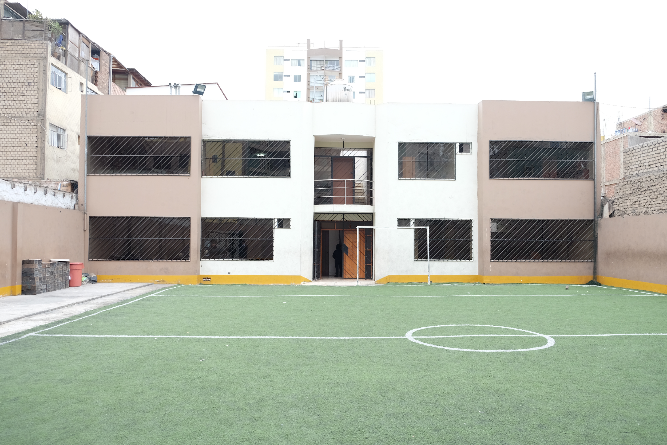
The Seminary of the Evangelical Lutheran Synod of Peru houses classrooms, a dormitory for students and the chapel for the Santa Beatriz congregation. Instead of a North American-style baseball field for recreation, a soccer pitch was installed! “Be shepherds of the church of God, which he bought with his own blood (Acts 28).”

Slide 12
Primarily, pastors are Called to preach/teach God’s Word and administer the Sacraments.
In our congregation, what best shows my pastor’s theological training?
How can we support our Seminary so others may be prepared for ministry?

Slide 13
Paul says of “servants of Christ” that “it is required that those who have been given a trust must prove faithful (I Corinthians 4).”
How does pastoral ministry sometimes look unsuccessful?
What is true evidence of a pastor’s faithfulness?

